Slide 1
Policy development workshop
The role and characteristics of appropriate supportive policy within Bandwidth Management and Optimisation (BMO)
Notes:
INASP Bandwidth management and optimisation workshop: Policy development
Copyright INASP/TENET – see: http://inasp.info/training/training-materials-copyright.html for more details
Licensed under a Creative Commons License, Attribution-NonCommercial-ShareAlike 2.5.
http://creativecommons.org/licenses/by-nc-sa/2.5/

Slide 2
Objectives
Review the characteristics of good policy
Assessed the degree to which the policy documents of participating institutions/other institutions meet the definition of good policy
Considered ways in which the policy documents can be improved
Notes:
INASP Bandwidth management and optimisation workshop: Policy development
Copyright INASP/TENET – see: http://inasp.info/training/training-materials-copyright.html for more details
Licensed under a Creative Commons License, Attribution-NonCommercial-ShareAlike 2.5.
http://creativecommons.org/licenses/by-nc-sa/2.5/

Slide 3
What is policy, anyway?
Cognate terms
  polis
  police
  political (with a small “p”)
Notes:
INASP Bandwidth management and optimisation workshop: Policy development
Copyright INASP/TENET – see: http://inasp.info/training/training-materials-copyright.html for more details
Licensed under a Creative Commons License, Attribution-NonCommercial-ShareAlike 2.5.
http://creativecommons.org/licenses/by-nc-sa/2.5/

Slide 4
No, really, what is it?
How is it different from strategy?
How is it different from regulations?
Who creates and owns it?
Notes:
INASP Bandwidth management and optimisation workshop: Policy development
Copyright INASP/TENET – see: http://inasp.info/training/training-materials-copyright.html for more details
Licensed under a Creative Commons License, Attribution-NonCommercial-ShareAlike 2.5.
http://creativecommons.org/licenses/by-nc-sa/2.5/
1 = The vision or dream
2 = how will get there
3 = direction on what is needed to get there
4 = Rules and regulations on getting there and guiding people on the way
1. Mission, vision and values are about objectives: what do we want?
2. Strategy is about the acquisition, development, deployment and renewal of resources in the pursuit of objectives: how are we going to get there?
3. Policy is about “directed behaviour”. We define some kinds of behaviour as acceptable and others as not, and we connect these definitions to our high-level definitions of where we want to go and how we plan to get there.
4. Regulations are the detail that policy mandates. So policy might say “the IT department shall from time to time set limits on traffic volumes” and the regulation might say “nobody may send an email attachment larger than 3 Megabytes.” Regulations are always made within the mandate established by policy. The do’s and don’ts
Policy is not regulation, regulations are defined from the policy. Policy is derived from the strategy.

Slide 5
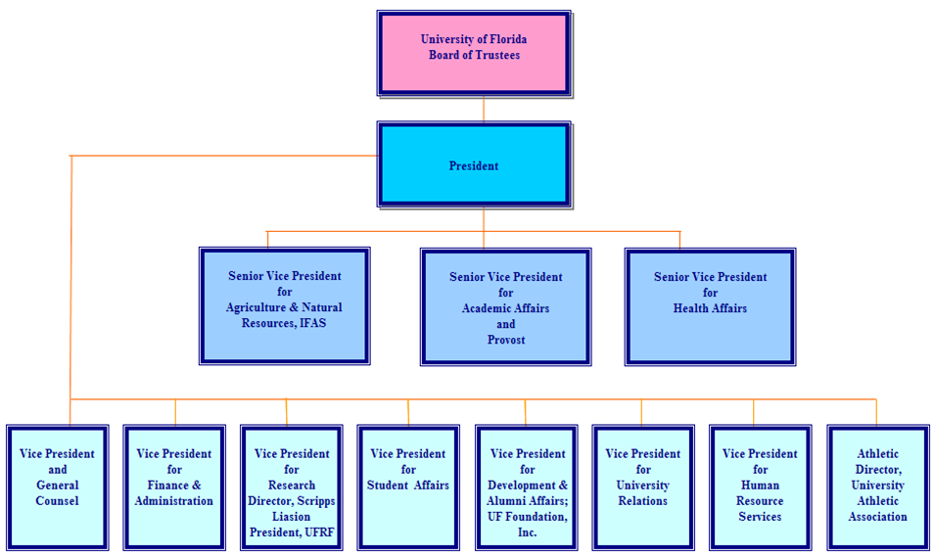
Typical university structure
Notes:
INASP Bandwidth management and optimisation workshop: Policy development
Copyright INASP/TENET – see: http://inasp.info/training/training-materials-copyright.html for more details
Licensed under a Creative Commons License, Attribution-NonCommercial-ShareAlike 2.5.
http://creativecommons.org/licenses/by-nc-sa/2.5/
- University board [Council] [Board of Trustees] – exercises final authority and fiduciary responsibility
- President [Vice-Chancellor] {Rector] – Chief Executive Officer
- Senior vice presidents in different areas [Vice-Rector] [Deputy Vice-Chancellor] Officers on the Executive Team
- Vice president and general counsel – these all tend to be of the “senior line management” class.
- Vice president for finance and administration
- Vice president for research, etc.
- Vice president for student affairs
- Vice president for university relations
- Vice president for human reosurces
Etc>

Slide 6
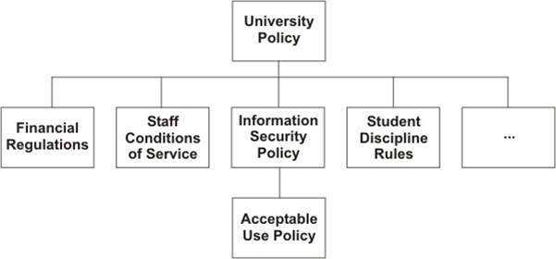
Typical policy structure
Notes:
INASP Bandwidth management and optimisation workshop: Policy development
Copyright INASP/TENET – see: http://inasp.info/training/training-materials-copyright.html for more details
Licensed under a Creative Commons License, Attribution-NonCommercial-ShareAlike 2.5.
http://creativecommons.org/licenses/by-nc-sa/2.5/
The wider policy environment...
This maps onto the organogram – each of these domains is typically managed by a senior figure and he or she has policy management responsibility for that domain. Policymaking might lie with an analogous committee – for example, Finance Committee, Staffing Committee, IT Steering Committee, etc.

Slide 7
Characteristics of good policy
Notes:
INASP Bandwidth management and optimisation workshop: Policy development
Copyright INASP/TENET – see: http://inasp.info/training/training-materials-copyright.html for more details
Licensed under a Creative Commons License, Attribution-NonCommercial-ShareAlike 2.5.
http://creativecommons.org/licenses/by-nc-sa/2.5/
Facilitators should have consulted the example policies and highlighted the policies that exhibit characteristics of good policy and those that do not. There is a commentary on some of these policies included – see: Sample-policy-commentary.doc – but in addition, facilitators should be familiar with the actual policies.

Slide 8
Enabling
Policy is not just a set of restrictions
Makes things possible
Encourages and enables users
Notes:
INASP Bandwidth management and optimisation workshop: Policy development
Copyright INASP/TENET – see: http://inasp.info/training/training-materials-copyright.html for more details
Licensed under a Creative Commons License, Attribution-NonCommercial-ShareAlike 2.5.
http://creativecommons.org/licenses/by-nc-sa/2.5/
Policy is not just a set of restrictions. It is a set of restrictions with a purpose: in particular, its central purpose is to make things possible. It does this by making other things impossible – things that would conflict with the achievement of organisational objectives. All this is obvious when you think about it, but the problem in Universities is that people don’t think about it – they just see policy as another irritating invention of the administration that doesn’t have any real relevance for them. Drawing out this connection is really important in getting policy buy-in.
i.e. An Internet AUP will allow more equitable access to bandwidth. Making it faster and better for the majority of users. It will only limit the abusers of the network, the majority of users should not see any limits to their use. This is often an issue of controlling 5-10% of (ab)users for the benefit of 90-95%.

Slide 9
Linked to a wider objective
Why have the policy at all?
  What is the institutional objective?
  How does the policy support it?
  Why should I support this policy?
Must be communicated and understandable
  To all stakeholders
  During the policy development process
  Essential to winning the argument for policy
Notes:
INASP Bandwidth management and optimisation workshop: Policy development
Copyright INASP/TENET – see: http://inasp.info/training/training-materials-copyright.html for more details
Licensed under a Creative Commons License, Attribution-NonCommercial-ShareAlike 2.5.
http://creativecommons.org/licenses/by-nc-sa/2.5/
As for the slide before. In fact, maybe we should just combine them?

Slide 10
Clear ownership
Who owns the policy?
  Is this clear from the policy document?
Is it the “right” ownership to ensure support and buy in?
  Not the IT department!
  The highest authority in the institution
Notes:
INASP Bandwidth management and optimisation workshop: Policy development
Copyright INASP/TENET – see: http://inasp.info/training/training-materials-copyright.html for more details
Licensed under a Creative Commons License, Attribution-NonCommercial-ShareAlike 2.5.
http://creativecommons.org/licenses/by-nc-sa/2.5/
Because defined roleplayers have responsibility for proposing, approving, amending and enforcing policy. Each of these roles needs to be spelled out.

Slide 11
Clear and concise
Clear and well written
No technical or legal jargon
Short, easily read and digested by users
Maybe two versions of the same document:
  One for all users to read and understand
  A supporting, full “legal” document if necessary
Notes:
INASP Bandwidth management and optimisation workshop: Policy development
Copyright INASP/TENET – see: http://inasp.info/training/training-materials-copyright.html for more details
Licensed under a Creative Commons License, Attribution-NonCommercial-ShareAlike 2.5.
http://creativecommons.org/licenses/by-nc-sa/2.5/
Because people won’t read something longer than a few pages. If the policy really has to be longer than that then somebody must write a digest of it, in clear, non-threatening language. People often bristle when they are confronted with the legalese of many policy documents; something clear and direct is always better.

Slide 12
Developed by process
Good processes secure buy-in and sense of ownership
  Both essential for successful policy development and implementation
Notes:
INASP Bandwidth management and optimisation workshop: Policy development
Copyright INASP/TENET – see: http://inasp.info/training/training-materials-copyright.html for more details
Licensed under a Creative Commons License, Attribution-NonCommercial-ShareAlike 2.5.
http://creativecommons.org/licenses/by-nc-sa/2.5/
Because processes are what secure buy-in and a sense of ownership. If the policy is a cut-and-paste job or is decreed from the office of the IT director or legal advisor then it stands the risk of failure. “Failed policy” in a university means a policy that is on the books but is not enforced.
More details on the process will be examined in the next section of the workshop.

Slide 13
Defined authority
Policy environment in a university is complex.
  Many overlapping domains of authority.
Good policy stays within its authority.
  Policy that exceeds its authority is set up for failure.
  Policy that conflicts with the law of the land is a disaster waiting to happen.
Notes:
INASP Bandwidth management and optimisation workshop: Policy development
Copyright INASP/TENET – see: http://inasp.info/training/training-materials-copyright.html for more details
Licensed under a Creative Commons License, Attribution-NonCommercial-ShareAlike 2.5.
http://creativecommons.org/licenses/by-nc-sa/2.5/
Because the policy environment in a university is a complex one, with many overlapping domains of authority. The AUP touches upon the staff conditions of service, the rules for student discipline, the rules of equipment use, and many others too. Policy that exceeds its authority is set up for failure. Policy that conflicts with the law of the land is a disaster waiting to happen.

Slide 14
Enforced
If the policy is not enforced, it will lose respect and trust by those who originally bought into it.
Notes:
INASP Bandwidth management and optimisation workshop: Policy development
Copyright INASP/TENET – see: http://inasp.info/training/training-materials-copyright.html for more details
Licensed under a Creative Commons License, Attribution-NonCommercial-ShareAlike 2.5.
http://creativecommons.org/licenses/by-nc-sa/2.5/
Universities are littered with policies that are not enforced. An un-enforced policy is a catastrophe waiting to happen, because when you really do need to enforce it – perhaps because of some especially egregious behaviour – you run the risk that the perpetrator can claim that policy was null and void because of disuse. The courts (or, more likely, your user community) might well support such a defense.
If the policy is not enforced universally, then when will it be enforced? How will those decisions be made?
It is much better to have a policy that is enforceable and is enforced. Otherwise, what is the point?

Slide 15
Good policy is adaptable
Situations change
Policy should be reviewed regularly
Important to keep consulting users
  Support from users is critical to success
  You cannot buy or bomb people into supporting your policy
Notes:
INASP Bandwidth management and optimisation workshop: Policy development
Copyright INASP/TENET – see: http://inasp.info/training/training-materials-copyright.html for more details
Licensed under a Creative Commons License, Attribution-NonCommercial-ShareAlike 2.5.
http://creativecommons.org/licenses/by-nc-sa/2.5/
Because the circumstances that gave rise to the policy imperative might change. Policy might need to become more restrictive; or it might be possible for it to be relaxed.

Slide 16
Thank you
Any questions?
Notes:
INASP Bandwidth management and optimisation workshop: Policy development
Copyright INASP/TENET – see: http://inasp.info/training/training-materials-copyright.html for more details
Licensed under a Creative Commons License, Attribution-NonCommercial-ShareAlike 2.5.
http://creativecommons.org/licenses/by-nc-sa/2.5/

Slide 17
This work is licensed under a Creative Commons Attribution-ShareAlike 3.0 Unported License.
Notes:
You are free:
to Share — to copy, distribute and transmit the work
to Remix — to adapt the work
to make commercial use of the work
Under the following conditions:
Attribution — You must attribute the work in the manner specified by the author or licensor (but not in any way that suggests that they endorse you or your use of the work).
Share Alike — If you alter, transform, or build upon this work, you may distribute the resulting work only under the same or similar license to this one.
http://creativecommons.org/licenses/by-sa/3.0/

